Slide 1

Dt. 12/12/2025
Scientific Calculator Using Python
NextHikes IT Solutions
Sarita Sahoo
Notes:
---

Slide 2

Overview
Project Introduction
  Introducing the scientific calculator project built using Python, highlighting team members and objectives.
Significance of Scientific Calculators
  Scientific calculators solve complex mathematical problems essential in education, engineering, and research.
Why Python?
  Python's simplicity, versatility, and powerful libraries make it ideal for developing advanced mathematical tools.
Practical Applications
  Customizable calculators built in Python efficiently handle trigonometric, logarithmic, and exponential functions.
Notes:
---
This slide references information from the following file: https://www.slideshare.net/slideshow/creating-a-tkinter-python-calculator-pptx/272937160
The presentation begins with a visually appealing title slide introducing the project: 'Scientific Calculator Using Python.' This slide should include the names of the team members involved in the project, such as Ayush Bariar, Digvijay Chavan, Rakesh Yadav, and Himanshu Maitry. The purpose of this slide is to set the stage for the audience by clearly stating the topic and acknowledging the contributors. A visually engaging design with a clean background, bold fonts, and relevant imagery like a Python logo or a calculator graphic will help capture attention. The introduction will briefly explain the significance of scientific calculators in solving complex mathematical problems and why Python is an ideal language for building such tools. Python offers simplicity, versatility, and powerful libraries that make implementing advanced mathematical functions straightforward. This section will also highlight the practical applications of scientific calculators in education, engineering, and research, emphasizing their role in enhancing productivity and accuracy. By using Python, developers can create customizable calculators that handle trigonometric, logarithmic, and exponential functions efficiently. The introduction sets the tone for the rest of the presentation, ensuring the audience understands the objectives and the value of the project.

Slide 3

Introduction to Scientific Calculator in Python
Advanced Mathematical Functions
  Scientific calculators perform trigonometric, logarithmic, and exponential functions essential for complex calculations.
Python's Math Module
  Python's math module provides extensive functions enabling complex mathematical operations in calculators.
Graphical User Interface
  Tkinter allows creation of user-friendly graphical interfaces for better interaction with the calculator.
Advantages over Hardware
  Python calculators offer flexibility, scalability, and features like memory storage and error handling.
Notes:
---
This slide references information from the following file: https://www.slideshare.net/slideshow/creating-a-tkinter-python-calculator-pptx/272937160
A scientific calculator is a specialized tool designed to perform advanced mathematical operations beyond basic arithmetic. It can handle trigonometric, logarithmic, and exponential functions, making it indispensable for students, engineers, and scientists. Python is an excellent choice for building such calculators due to its simplicity, readability, and extensive library support. The introduction will explain how Python's math module provides functions for complex calculations and how Tkinter enables the creation of a graphical user interface for better user interaction. This section will also discuss the advantages of using Python over traditional calculator hardware, such as flexibility, scalability, and the ability to integrate additional features like memory storage and error handling. By leveraging Python, developers can create a robust and user-friendly scientific calculator that meets diverse computational needs.

Slide 4
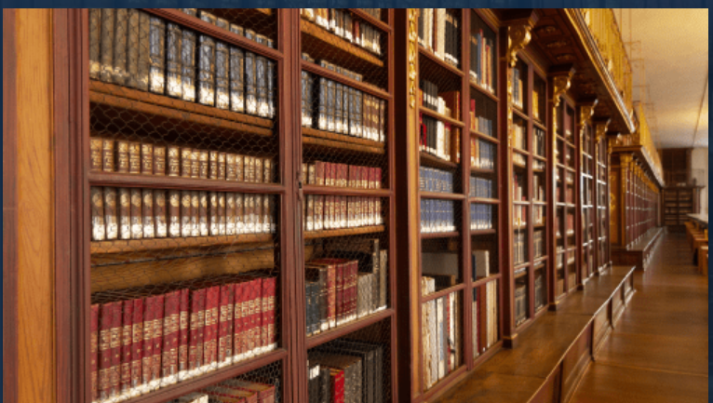
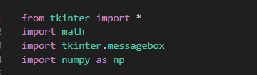
Libraries Used
Math Module Utilities
The math module enables complex calculations like trigonometric, logarithmic, and exponential functions essential for scientific computing.
Tkinter GUI Framework
Tkinter provides tools to create interactive graphical user interfaces for user-friendly calculator operation.
Error Handling with Messagebox
The tkinter.messagebox module helps in displaying error messages and notifications for better user communication.
Notes:
---
This slide references information from the following file: https://www.slideshare.net/slideshow/creating-a-tkinter-python-calculator-pptx/272937160
The development of a scientific calculator in Python relies on several key libraries. The math module is essential for performing advanced mathematical operations, including trigonometric, logarithmic, and exponential functions. Tkinter is used to create a graphical user interface, allowing users to interact with the calculator through buttons and display screens rather than text-based commands. Additional libraries like tkinter.messagebox can be employed for error handling and user notifications. This section will provide an overview of these libraries, explaining their roles and functionalities. Visual elements such as library logos and code snippets will be included to enhance understanding. By using these libraries, developers can build a calculator that is both functional and visually appealing, offering a seamless user experience.

Slide 5
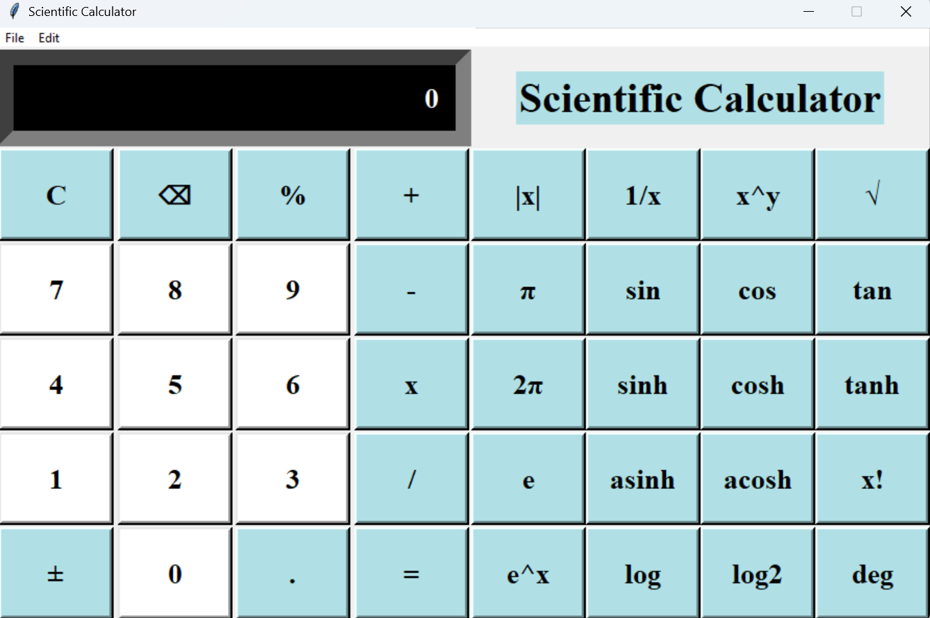
Outcome:
Beyond basic arithmetic, incorporated advanced mathematical functions to implement a scientific calculator as specified below:
Trigonometry : Sine (Sin) Cosine (Cos) Tangent (Tan)
Logarithms: Ln (Natural Log) Log base 10
Exponential: e^x x^y
Notes:
Image source: Microsoft 365 content library
Focusing on calculator output ensures accuracy in problem-solving by verifying each calculated result. It helps identify potential errors early, reducing mistakes in the final answer. Additionally, reviewing calculator output allows for better understanding of numerical relationships and can enhance overall mathematical skills.

Slide 6

References
https://www.geeksforgeeks.org/python/python-simple-gui-calculator-using-tkinter/
https://docs.python.org/3/library/math.html
https://www.geeksforgeeks.org/python/python-gui-tkinter/
https://wiki.python.org/moin/NumPy
Notes:
---
This slide references information from the following file: https://www.slideshare.net/slideshow/creating-a-tkinter-python-calculator-pptx/272937160
Beyond basic arithmetic, scientific calculators must support advanced mathematical functions such as trigonometric calculations (sine, cosine, tangent), logarithmic operations, and exponentiation. This section will explain how these functions are implemented using Python's math module and integrated into the calculator's interface through Tkinter. Code examples will be provided to illustrate the implementation, and animated graphics will depict the mathematical concepts for better comprehension. By incorporating these advanced features, the calculator becomes a powerful tool capable of handling a wide range of computational tasks.

Slide 7

Summary and Roadmap
Summary of Functionalities
The calculator supports basic arithmetic and advanced math operations using Python libraries like math, numpy and Tkinter.
Role of Python Libraries
Libraries such as math and Tkinter simplify the development process and enhance calculator capabilities.
Future Enhancements Roadmap
Plans include
1. adding memory storage, 2. history tracking,
3. improved error handling for better usability.
4. More Flexible UI design
5. Using functions handling multiple variables.
Notes:
---
This slide references information from the following file: https://www.slideshare.net/slideshow/creating-a-tkinter-python-calculator-pptx/272937160
The conclusion will summarize the key points covered in the presentation, reinforcing the importance of scientific calculators and the advantages of implementing them using Python. It will highlight the functionalities achieved, including basic arithmetic and advanced mathematical operations, and the role of libraries like math and Tkinter in simplifying development. The roadmap for future enhancements will suggest adding features such as memory storage, history tracking, and error handling improvements. Visual elements like a timeline graphic will illustrate these future plans, providing a clear vision for the continued evolution of the project.

